Slide 1
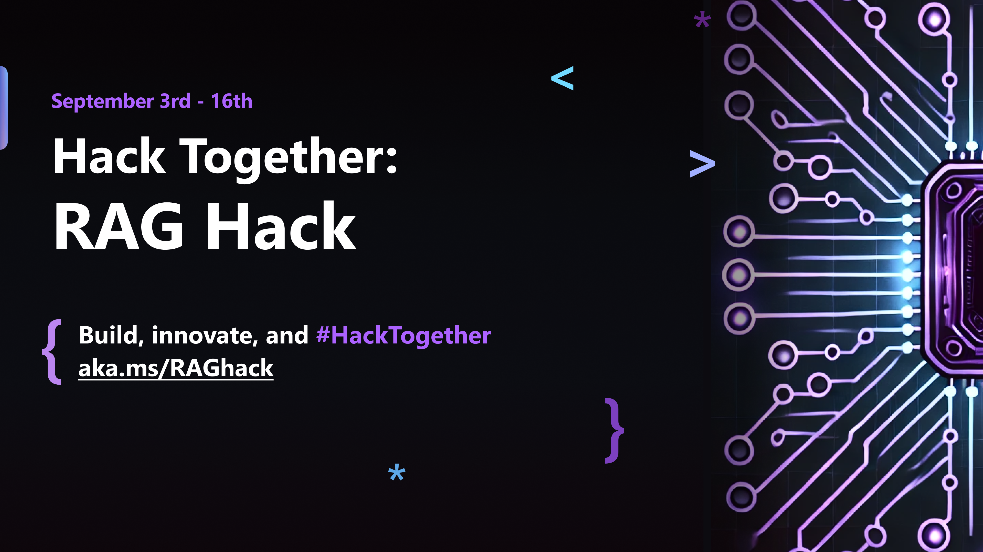

Slide 2
Pick the right model for the right job
Facundo Santiago Principal Product Manager @ Azure AI https://medium.com/@santiagof
https://linkedin.com/in/santiagxf

Slide 3
Agenda
Guess what? Someone released a new model
Model selection
Azure AI model catalog
Demo: Switching models
Demo: Evaluating models

Slide 4
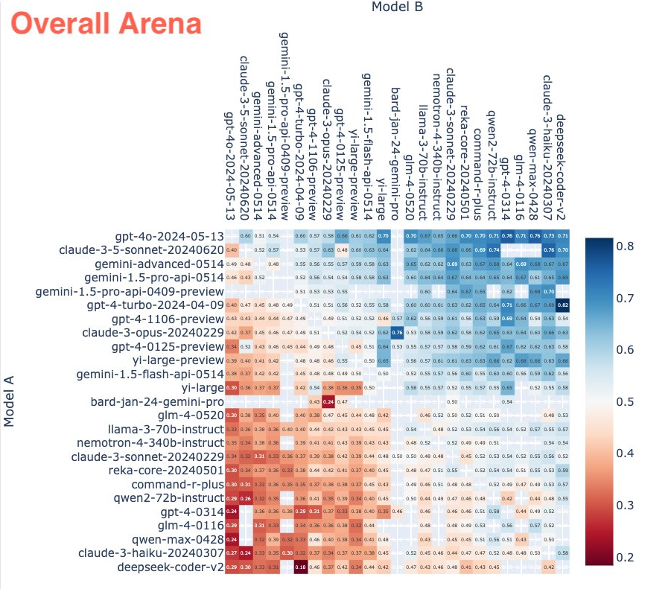
Which model should I use?
Source: https://lmsys.org/

Slide 5
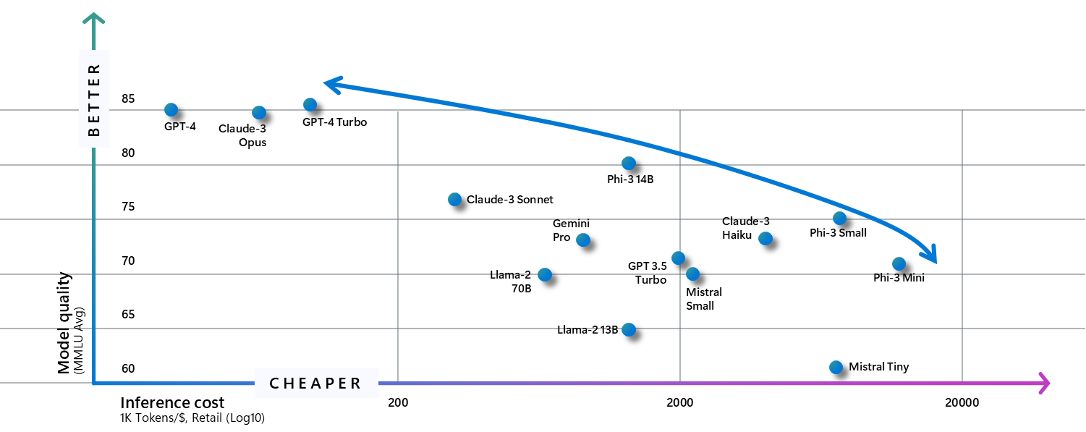
SLMs are pushing the price-performance envelop like never before

Slide 6
Model choice matters in the real world
ADVANCE PROJECT
ADVANCE PROJECT
Monitoring
Capacity and cost trade offs
Security and data privacy
Deploy LLM App/UI
Model selection
Content Filtering
Techniques - Prompt Engineering, RAG, Fine-tuning
Establish feasibility
Define use cases
Pick a flagship model
Build prototypes
Can AI solve my use case?
What is the best model for my use case?
Can I scale for real-world workloads?
REVERT PROJECT
REVERT PROJECT
Prototype
Optimize
Operationalize

Slide 7
Azure AI model catalog

Slide 8
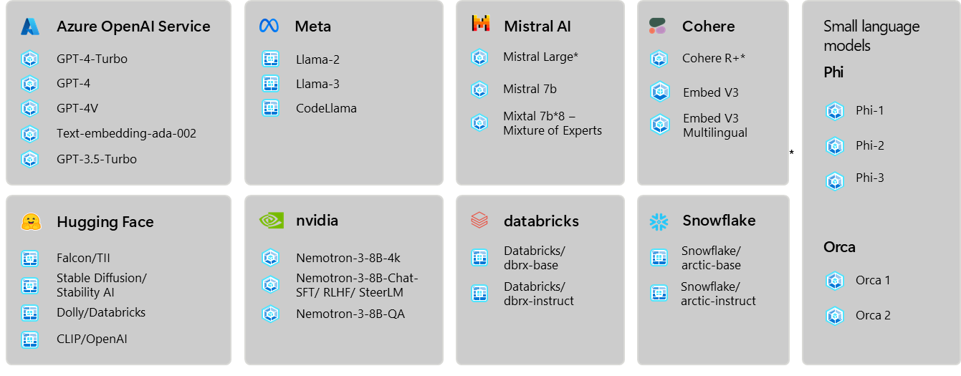
Offering a breadth selection of frontier and open models

Slide 9

Security and privacy when running on Azure
Data privacy
Security and Compliance
Responsible AI and
Content Safety
Your data is not shared with model providers
Your data is not used for training models
Model vulnerability scanning
Private networks
Entra ID authentication
Industry certifications
Azure SLA
Built in Content Safety filters.
Evaluation tools

Slide 10
Inference over a common schema

Slide 11
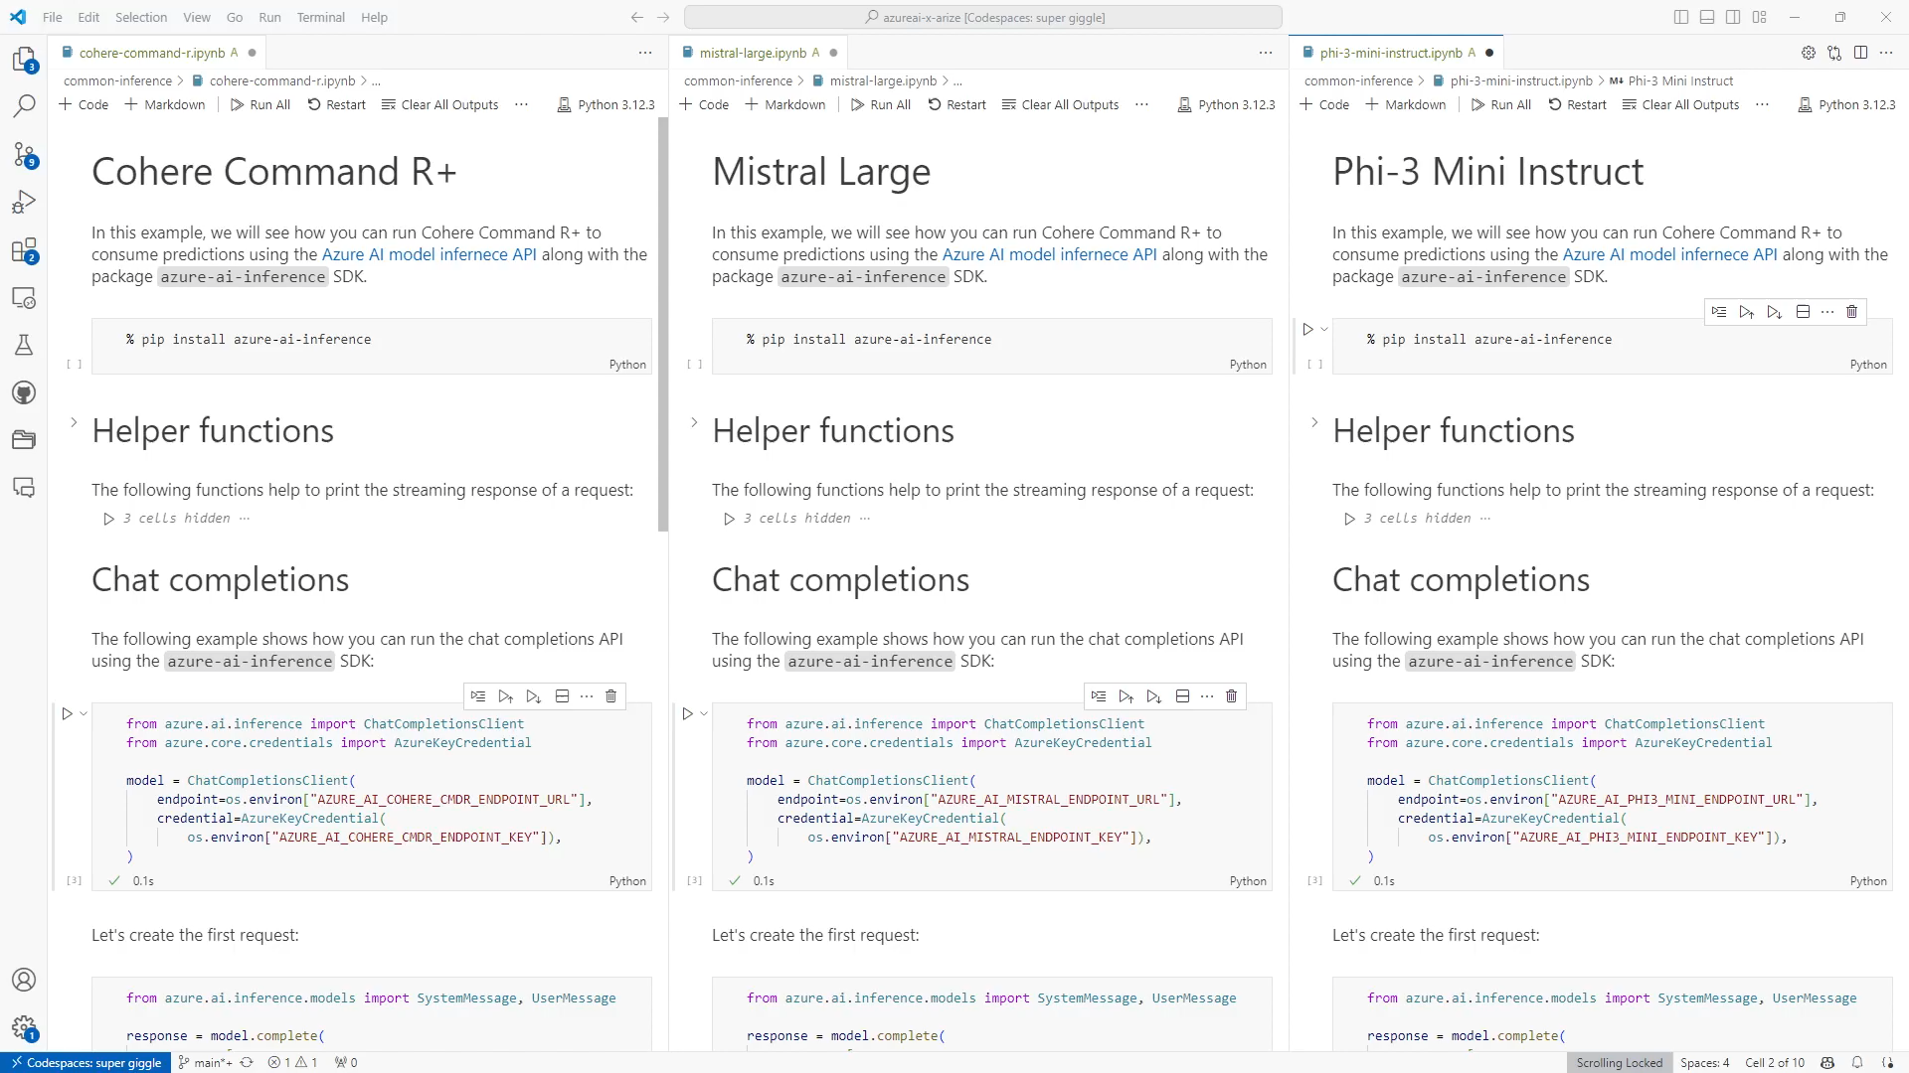

Slide 12
Let’s see a concreate example

Slide 13
Building a RAG system
Question : What did Paul Graham do after RICS?
Router
Retrieve (multiple)
Summarize
Answer
Data store (index)
Vector index
Retrieve
Answer
Summary tree

Slide 14
Demo

Slide 15
Did it affect performance?

Slide 16
Evaluation
Retrieval score
Groundedness Faithfulness
GPT Similarity F1 score
Question | Context | Answer | Growth truth
Relevance

Slide 17
Demo

Slide 18
Thank you ☺
Source code @ https://github.com/santiagxf/azureai-rag-hack

